Slide 2
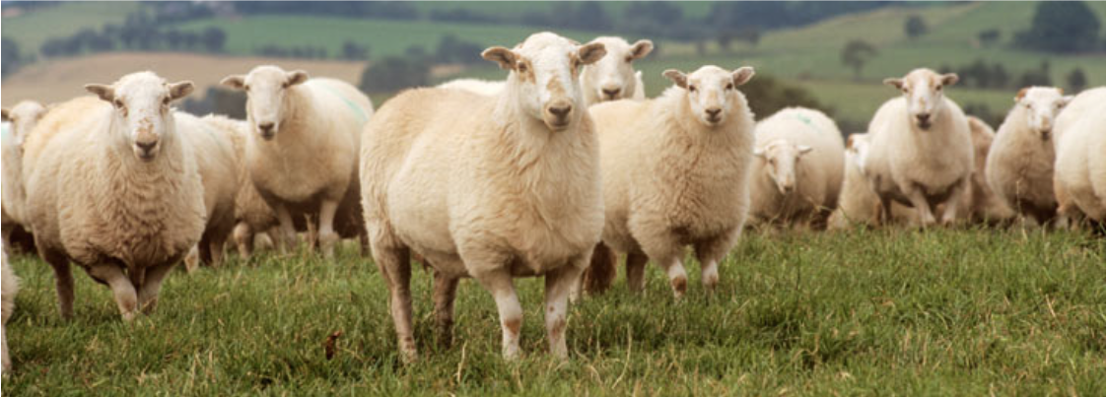
In the beginning…

Slide 3
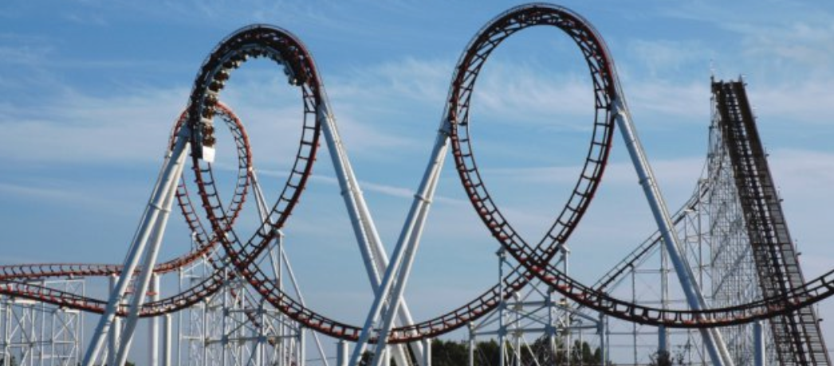
And then…

Slide 4
Planning
Local grid
National grid
Outbid
Change of subsidies
Dubious corporate behaviour

Slide 6
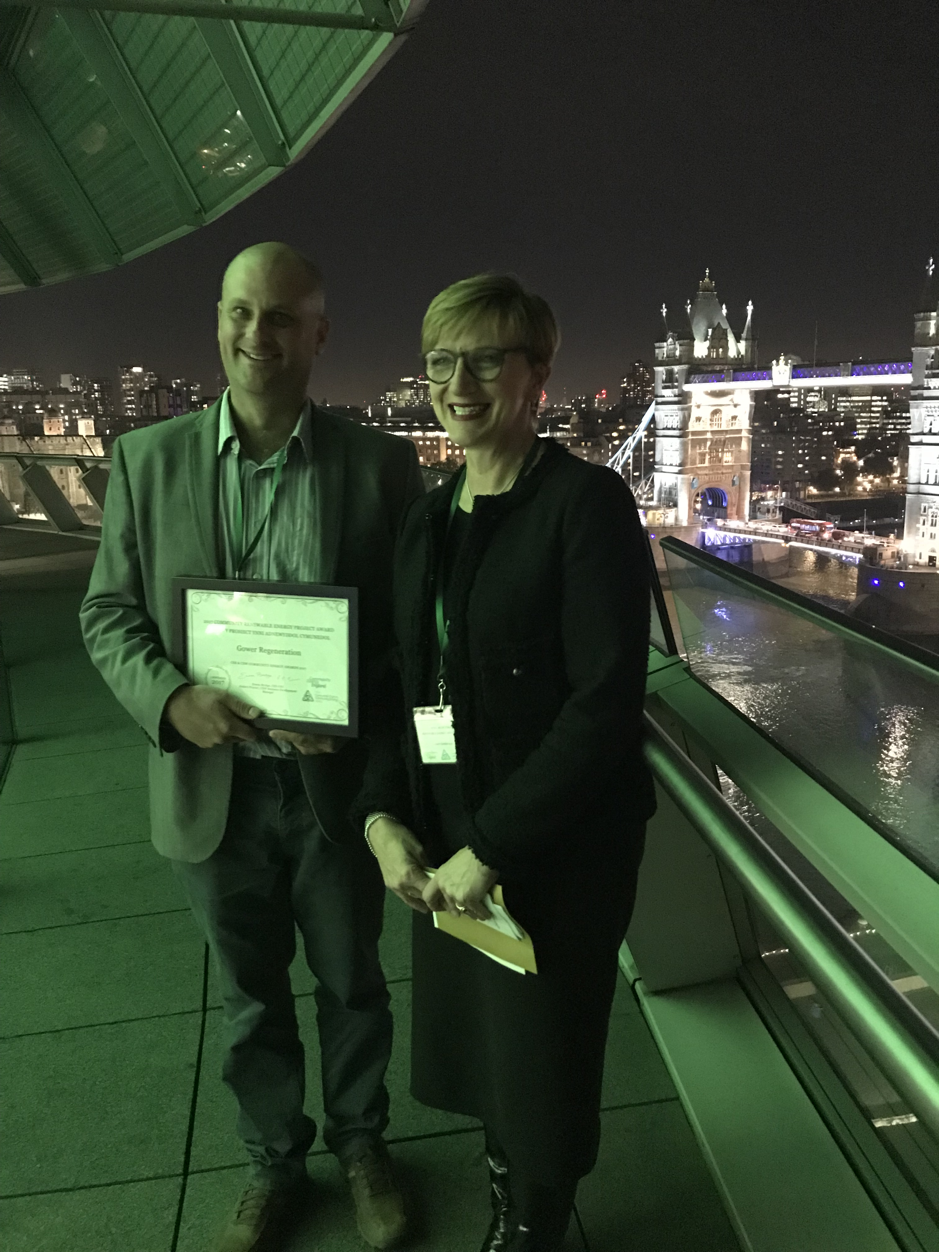
SHARE OFFER CLOSED AFTER RAISING £905,640
(Over 55% of investors from City and County of Swansea)
2017 Community Renewable Energy Project Award WINNERS
‘The most commendable sustainable electricity generation project undertaken by a community group across Wales and England.’

Slide 7
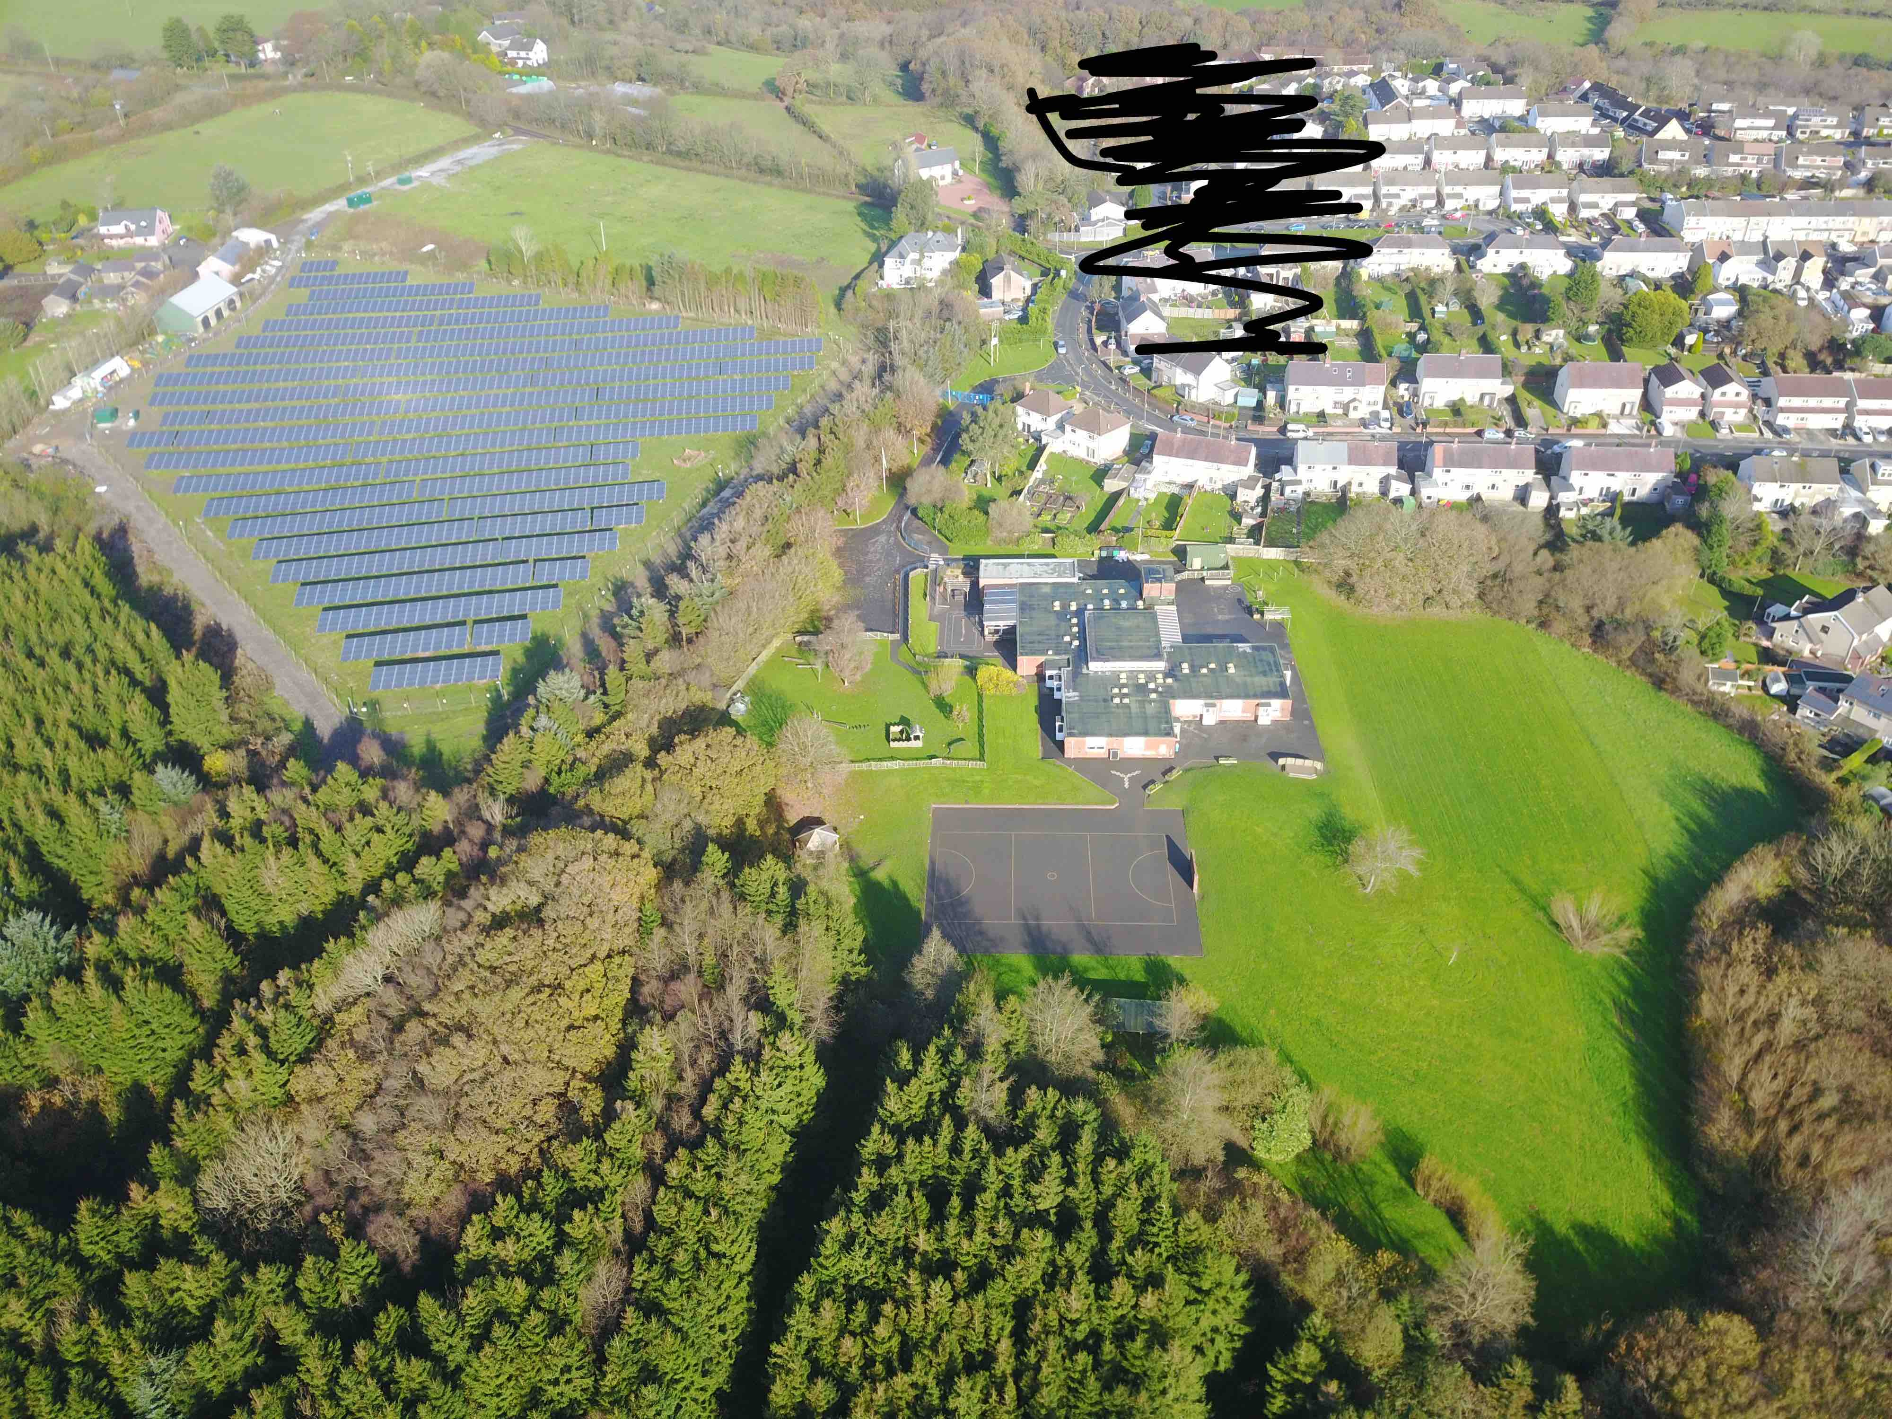

Slide 8
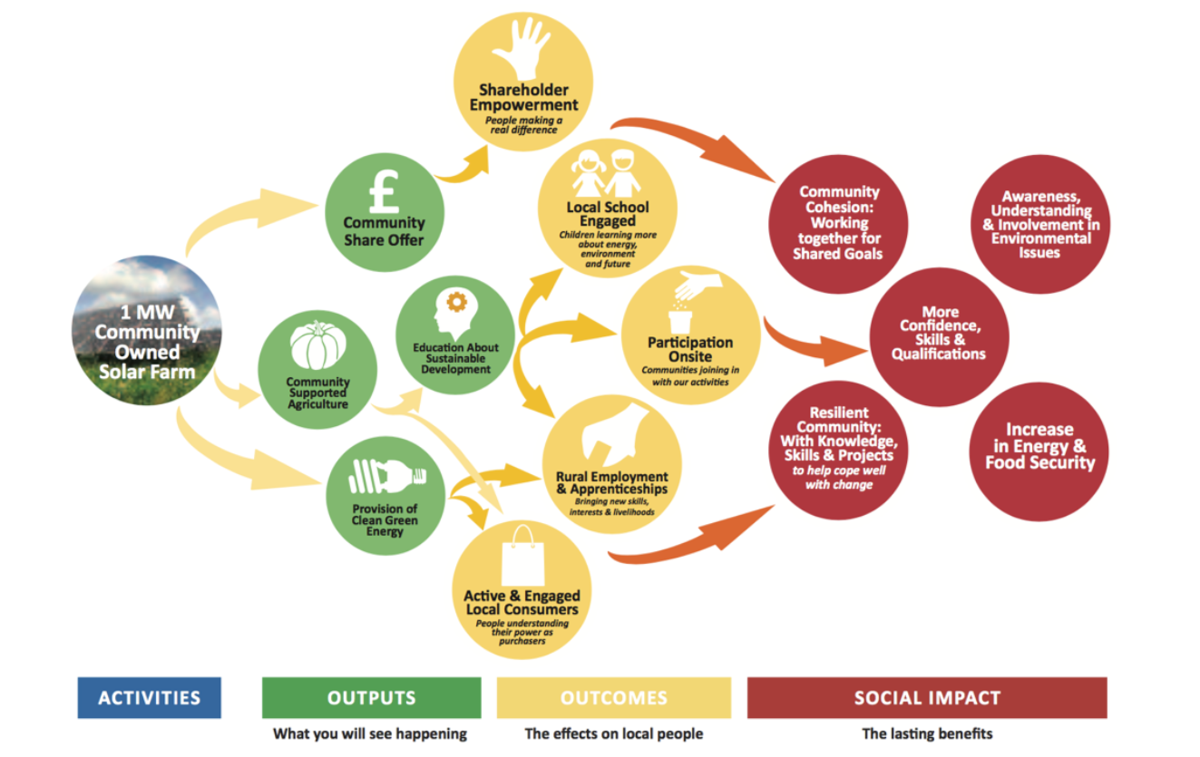
What is Gower Regeneration about?

Slide 9
Rough proposal

Slide 10
Thinking longer term….
An eco-classroom accessible from the school
Developing educational resources that link to the curriculum
Also linking the school better with the Gower Heritage Centre
Developing horticulture and other community assets onsite
Helping the school save costs on energy bills

Slide 11
But……
Construction issues
Financing issues
Escalating legal / technical costs = less community benefit funds ☹

Slide 12
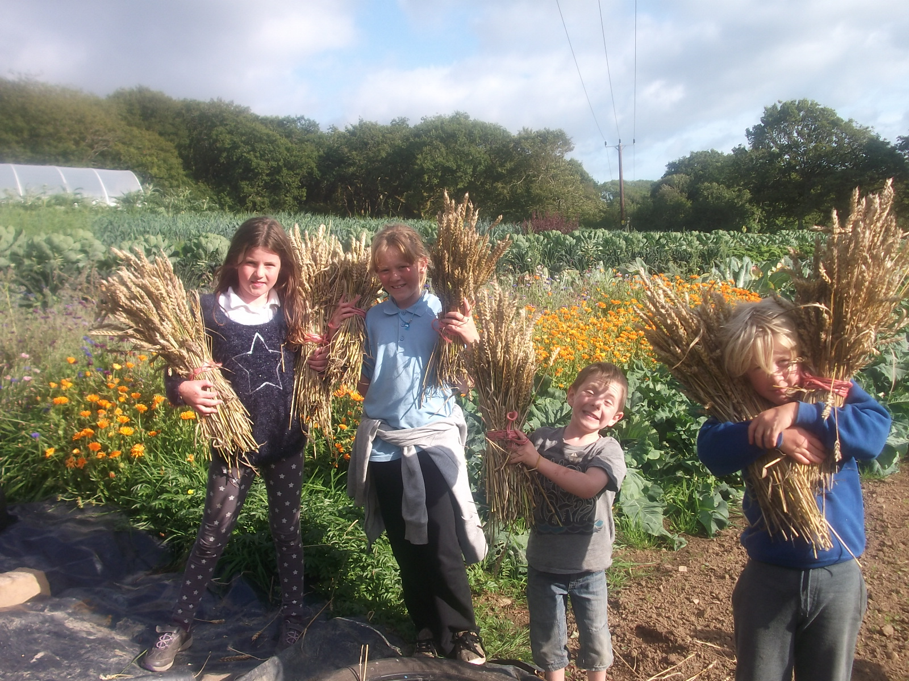
In the meantime……

Slide 13
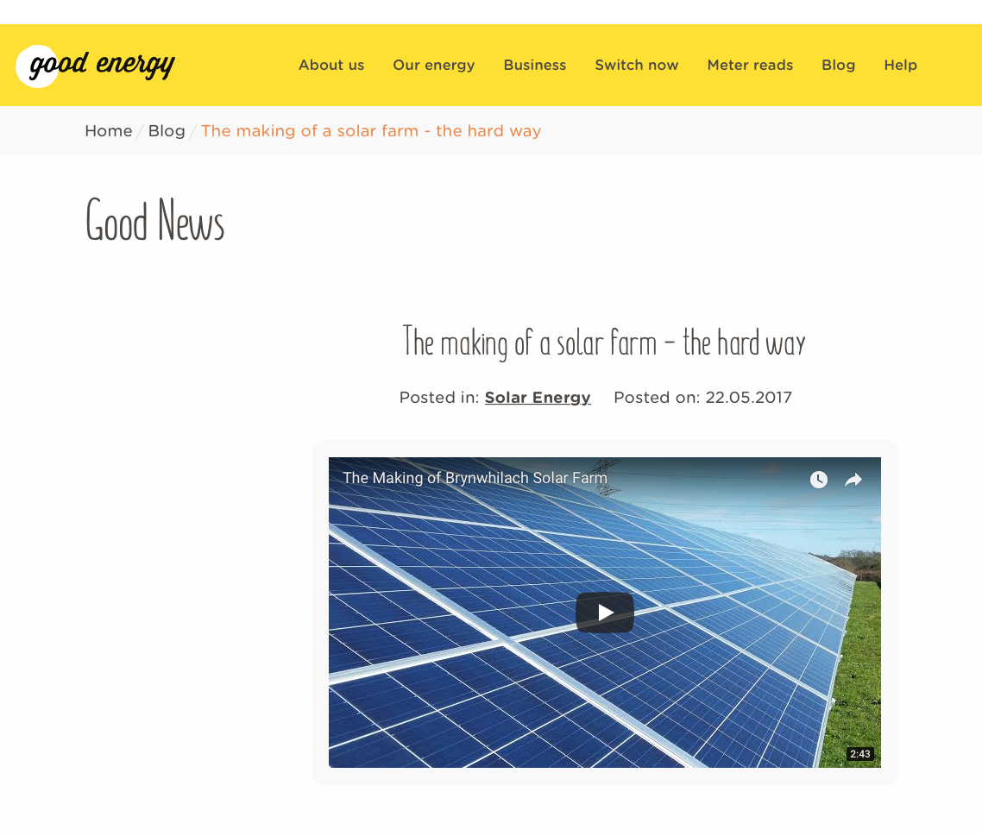
What next?
5MW operational
Development rights for 5MW more!

Slide 14
What next?

Slide 15
www.gowerpower.coop
www.regengower.co.uk
www.swanseacommunityenergy.org.uk
ant@gowerpower.coop
Twitter / FB = @gowerpowercoop
Ant Flanagan – 0782 4860803

Slide 16
https://www.youtube.com/watch?v=8bWRxzWKffo

