Slide 1
THE ELECTORAL REGISTER
Linda Savory
Electoral Registration Public Awareness Officer
Vale of Glamorgan Council
01446 709305 ljsavory@valeofglamorgan.gov.uk
Notes:
Thank you to the speaker and the school for inviting me to speak on behalf of Elec Reg.
Good morning to the students and introduction.

Slide 2
Introduction
What is the Electoral Register?
Why should we register to vote?
Who can register?
How can we register?
Can we register today?

Slide 3
What is the Electoral Register?
There are 2 registers
The Full Register
Everyone’s name and address will appear on the full version of the electoral register. The full version of the register is only used for:
Elections
Preventing and detecting crime
Checking applications for loans or credit
The Open Register
The Open Register is an extract of the electoral register, but is not used for elections. It can be bought by any person, company or organisation. Names will be included in the open register unless the elector has opted out.

Slide 4
Why should we register to vote?
To be able to vote and have your say
Confirmation of Identity
Apply for credit
Improve credit score
Proof of residence

Slide 5
Who can register?
If you are 14 or 15 you’re able to register
If you are 16-17 and you live in Wales, you can vote in Local Elections & Senedd Cymru/Welsh Parliament elections
If you are a qualifying foreign national living in Wales, you can register in certain elections
If you are18 years and over you can vote in any elections
Notes:
If you are 14 or 15 you can register your details so that you are ready in the system for when you turn 16.
If you are 16 or 17 you can register and vote in an up and coming Local & Senedd Elections.
Once you turn 18 and you are a qualifying foreign citizen residing in Wales you can register and vote in any other Elections, although your nationality may only qualify you to vote in certain elections. (A qualifying foreign citizen is someone who has or does not require leave to remain, or is treated as having leave to enter or remain in the UK).

Slide 6
How can we register?
www.gov.uk/registertovote
01446 729552
Invitation to Register
You must register individually.
If you have turned 16 when you apply,
you will need your
National Insurance Number

Slide 7
www.gov.uk/registertovote

Slide 8
Notes:
Here is the register to vote page, this will tell you a little bit of information about the register about who can register and things that you may need to know. Click “start now” to apply.

Slide 9
Notes:
Confirm where you live

Slide 10
Notes:
Confirm you nationality. If you are unsure, you can click on “Help with nationality” for more information

Slide 11
Notes:
Add your date of birth. This page will work out your age to see if your National Insurance Number is required.

Slide 12
Notes:
Please add your full name, no nick names or broken down shortened version of your name. You should enter this as it would state on your birth certificate.

Slide 13
Notes:
You will not be asked this question if you are 14 or 15 years of age. You will only be required to give this information once you turn 16 years old.

Slide 14
HM Revenue & Customs
0300 200 3502
www.gov.uk/lost-national-insurance-number
Notes:
If you have turned 16 and you do not know your National Insurance number or have not received it, you can click on the blue text under the box which will open up to give you the opportunity to explain why you don’t have it. You will still need to provide this information once you find or receive it. Your application will remain on hold until it is supplied. If you have turned 16 and it hasn’t been sent to you yet, you can contact HM Revenue & Customs on 0300 200 3502 or on-line at www.gov.uk/lost-national-insurance-number

Slide 15
Notes:
Add your postcode and find address

Slide 16
Notes:
Once you have done this you will be able to click to open all the addresses within this postcode so that you can select your address. Then continue.
If you can’t find the address in the drop down list, click the text saying ‘I can’t find my address in the list’ and it will let you free type an address.

Slide 17
Notes:
If you live at 2 homes and are not a student, you will need to confirm which address is their main home (or where you spend most of your time) . You can only register once. However there is one exception to this, if you decide to go to higher education (residential college or University living away from home) you can register at both your home address and education address, but you must only vote from one address in an election (this is in law).

Slide 18
Notes:
If you click yes it will ask you to find their previous address

Slide 19
Notes:
If you are 14 or 15 you should be automatically opted out of the register so that your details or not passed on.
If you are 16 or over you will be given the choice to opt out of the register. Please bare in mind what we discussed earlier about the open register. If you opt out, your details will not be passed to any third party, company or organisation to send you junk mail.

Slide 20
Notes:
If you are not sure, you can check the information again by clicking on the blue text under the box before you make your decision, you can change your mind at any time but you will need to contact us directly.

Slide 21
Notes:
You can decide if you would like to go to the polling station on voting day and vote in person, tell us if you already have a postal vote or yes you would prefer to vote by post. We will then send you a form to complete, please remember to complete and return this form when you receive it as your signature is required to set this up for you.

Slide 22
Notes:
Please supply this information as it is important for us to be able to contact you if there is a problem with your application. Also by supplying your email address and mobile number we can from time to time send you important information about your entry on the register or an up and coming election. Please be assured your contact details are not passed on to any other person.

Slide 23
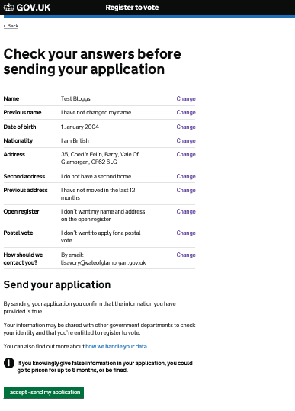
Notes:
Please check all your answers before submitting your application. You can go back to any part of your application if you wish to amend any part before submitting.

Slide 24
Notes:
Once you submit you will be given a reference number. It is recommended that you make a note or take a screenshot of this reference number should you need to contact the office about your application. Once the application is verified and accepted a confirmation letter will be sent and this confirmation letter can also be used as proof of identity.

Slide 25
What have we looked at today?
What is the Electoral Register?
Why should we register to vote?
Who can register?
How can we register?
We registered today

Slide 26
Notes:
Thank you for listening to me today.
Teachers note – if any of your students would like to raise ideas or comments about this presentation or requires more information please feel free to allow the student to contact myself using the contact details found on slide one.
Many thanks
Linda Savory

Slide 27
How can we register?
www.gov.uk/registertovote
01446 729552
Invitation to Register
Notes:
For anyone who did not register today please make a note of the website or contact details so that you can apply at home.

