Slide 1
WELCOME!
Plan for Pride 2023
Corporate Suite

Slide 3
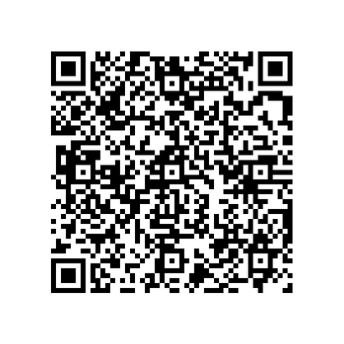
Pride Cymru Parade
This year the Pride Cymru event will take place on Saturday & Sunday, 17th & 18th of June
Vale of Glamorgan Council have reserved a place to march in the parade through Cardiff on Saturday 17th of June
Line Up – 9.30-10.30
Parade Begins – 11.00
Approx Finish – 13.00
Start – Castle Street
Finish – Kingsway
To join the celebrations and march in the parade, please register your interest by scanning the QR Code – Further details will follow shortly.

Slide 4
What's new?
GLAM Teams Group
GLAM Email Signature
New GLAM Signature can be used by members and allies of GLAM
GLAM Corporate Logo
GLAM Members will have access to a GLAM Teams Group. This will be a safe space for all members to ask questions, share resources and recommendations. It will also give the opportunity for the leadership team to share important information

Slide 5
What's new?
GLAM Teams Backgrounds
New GLAM Teams Background are being rolled out by IT this week

Slide 6
The Future of GLAM
Fully updated Staffnet & Staffnet+ Page
New GLAM Structure, creating more flexibility for members and allies to contribute where and when they can.
Incorporating GLAM into schools for staff to be included in the network and kept up to date
Regular Leadership and Member meetings to feedback and plan
Continued work on the Stonewall Workplace Index to create an even more inclusive workplace for everyone

Slide 7
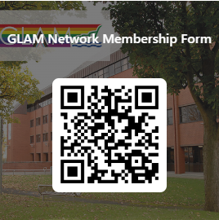
Thank you for attending!
Plan for Pride 2023
If you are not yet a member of GLAM, but wish to join, please scan the QR code below and complete the membership form for updates.

